Slide 1
CS 152 Final Project
Release: The Journaling App
Alan Viollier
CS 152 Section 5
Programming Paradigms

Slide 2

Introduction
“Create anything as long as it follows a programming paradigm”
Mental health has been considerably declining due to Covid-19. This has forced people, myself included, to find ways to care for their mental health in tough times.
Journaling. Simple & low-cost way of improving mental health
writing/typing thoughts as is, symptoms worry, todo, improvements, stressors.
Journaling allows you to release all the thoughts bearing your mind down, be aware of them, process them, and take a step away from them.
GUI-based application named “Release” that allows you to journal & track symptoms

Slide 3
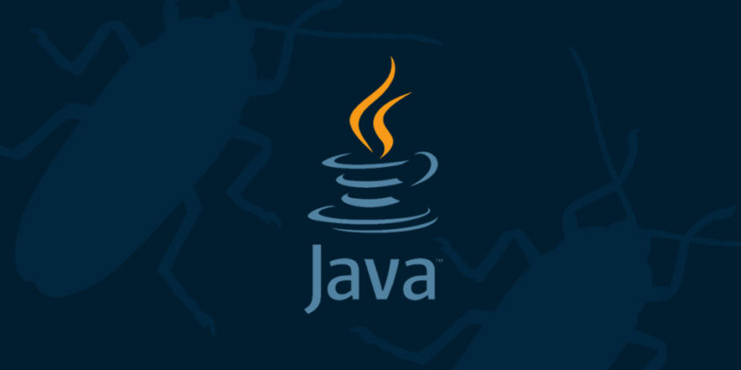
Programming Paradigm
Java
Multi-paradigm language but primarily Object-Oriented, making designing and developing classes for a GUI program easier.
Write a collection of classes that create objects that can communicate with each other.
More modular, which makes it easier to reuse and troubleshoot.
Inheritance to pass variables and methods to more specific versions of classes. Reuse code and make things clearer.
Although not used polymorphism allows flexibility in function arguments
Overall great choice for GUI.

Slide 4
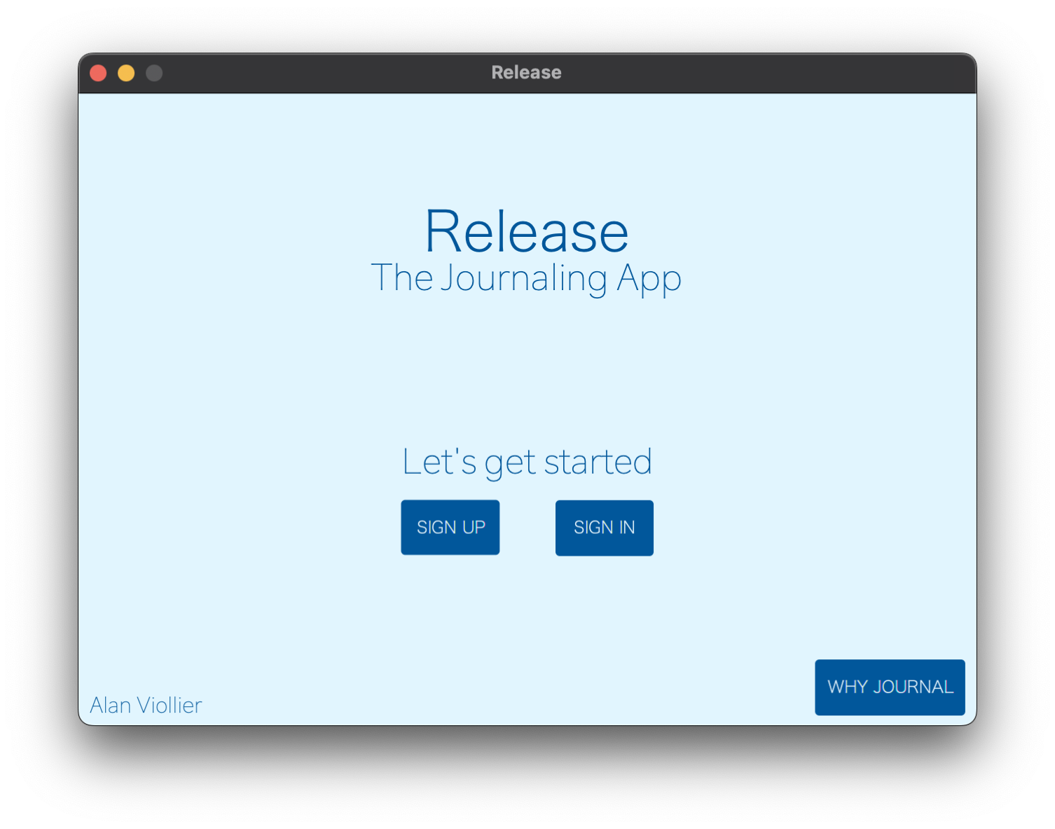
Project Demo

Slide 5
Conclusion
Object-oriented paradigm in java
Fully functional journaling and symptom-tracking application.
Learned more about the different types of programming paradigms. I refined my knowledge of object-oriented programming. I improved my Java language skills.
Improvements:
Mobile
Hashed passwords
JavaScript

Slide 6
Thank you!

